Slide 1
HTML5 Workshop : Shopping Cart
Persistent Interactive | Persistent University
Notes:
Lets discuss what is Web Data Storage in HTML5.

Slide 2
Key learning points :
Workshop session to give hands on practice.
Content is available on Knowledge center.
Queries on concepts to be avoided to be able to finish the example in time.
Any queries can be noted down and posted on the learning group.
Design and layout can be lot more customized.
But we will stick to one design in this session.
Use browser debuggers for code issues as session is on web ex.
Application is from SLT point of view
Prerequisite is Javascript, Jquery and Basic HTML5 concepts.
Notes:
The Key Learning Points are as follows.
* Existing Cookie based Model and Problems.
* New Storage Options Local storage and Session storage.

Slide 3
Code Structure with html files has been shared with you on learning group.
http://persistentuniversity.persistent.co.in/CollaborativeLearningGroup/View.aspx?SkillID=5558

Slide 4
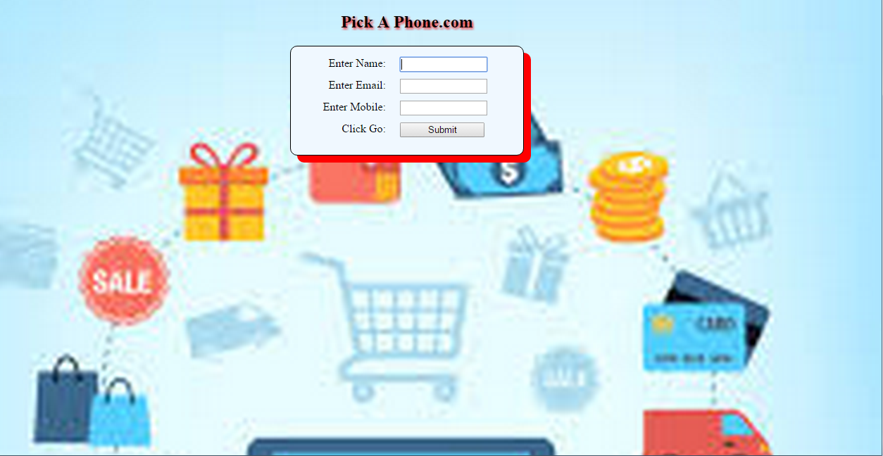
Startup Page

Slide 5
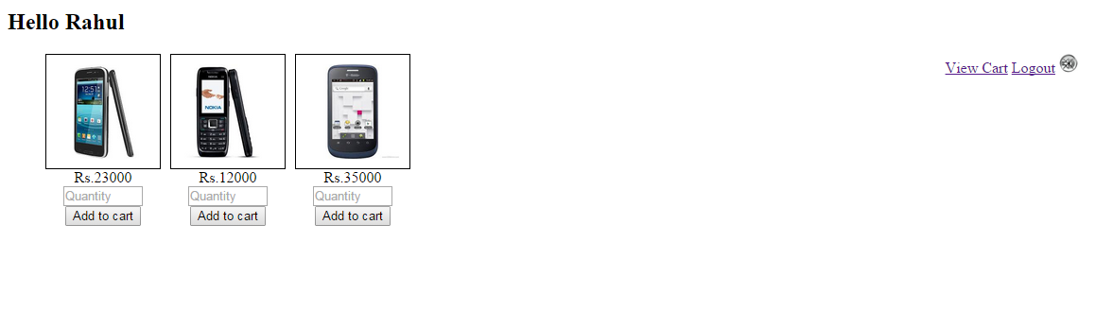
Main Page

Slide 6
First Page
Create a form with 3 fields with appropriate input types and a submit button
Place the form in the center and apply css
Give a background color to form
Give a heading to page and align to center
Make name as required field
On form submit, store the name in sessionStorage
On form submit, redirect to mainPage

Slide 7
Second Page
Display username from session Storage
For simplicity assume static images.
Place 3 images in a <ul>
Remove the list-style
Apply float to place them side by side.
Add quantity, price and “add to cart” button.
Add handler for “add to cart”.

Slide 8
Add to Cart
Fetch the quantity, price and productId using jQuery selectors
Create an item list and add the item to it.
Store the item list in session storage.
Also append the new item to the cart table.

Slide 9
Add music
Add <audio> to page with given mp3.
Add an icon to put off music
Add a handler for the icon to put off music
In the handler, call audio.pause() and set currentTime=0;

Slide 10
Fetching Discounts
On click of “discount”, create a web worker and post the items array.
Add a listener for ‘message’ event in the worker
The worker will iterate over items and give a 1000/- discount for each item.
The worker must return the final price to be paid by user.
Add a listener for ‘message’ event in the mainPage script.
In the listener function, fetch the finalPrice and display in the span.

Slide 11
References
Why use margin:auto
http://www.w3schools.com/css/css_align.asp
http://stackoverflow.com/questions/3170772/what-does-auto-do-in-margin0-auto
CSS3 generator
http://www.css3generator.in/default.html#box-shadow-generator
Why use inline:block
http://joshnh.com/2012/02/07/why-you-should-use-inline-block-when-positioning-elements/

